Slide 1
Malpractice Liability & Defensive Medicine
Prof. John Adwok
MBBS, MMed(Surg.), FRCS, FACS, PhD.
Chairman, SSGMC
Consultant General and Endocrine Surgeon
Nairobi Hospital

Slide 2
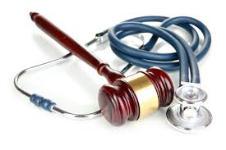
Defensive Medicine
Defensive medicine occurs when doctors order tests, procedures, visits, or avoid high-risk patients or procedures primarily to reduce their exposure to malpractice.
Extra tests or procedures to reduce malpractice liability are referred to as Positive Defensive Medicine.
Avoiding certain patients or procedures is referred to as Negative Defensive Medicine.
Notes:
Concerns about liability drive doctors to order tests, procedures, and specialist consultations whose expected outcomes are very low.

Slide 3
Background
Changes in the medico-legal landscape with increasing incidents of litigation have made doctors wary of the amount, quality, and type of treatment they offer.
Patients’ expectations have risen with the improvement in delivering quality medical interventions and they have developed a tendency to sue their doctor when the doctor delivers care they presume to be less than perfect.
A number of clinical and non-clinical factors affect the scope of defensive medicine practiced by doctors.
Adwok, 2013; Rutsohn & Sikula, 2007

Slide 4
Clinical Factors Affecting the Scope of Defensive Medicine
  Patient symptoms
  Seriousness of the suspected disease
  Degree of certainty about diagnosis
  Accuracy of the available diagnostic tests
  Risks and benefits of treatment

Slide 5
Non-clinical Factors Affecting Scope of Defensive Medicine
Availability of technology
The doctor’s specialty and training
Practice organization (solo, group, hospital-based)
Familiarity with the patient
Awareness of and sensitivity to test costs
Financial incentives
Patient expectations
Insurance status of the patient

Slide 6
Scope of Defensive Medicine
Hospitals and other stake holders know or suspect that many doctors change their clinical behavior as a response to the threat of malpractice liability.
The magnitude of the problem became evident about a decade ago in a survey research study among Pennsylvania doctors in 6 medical specialties at high risk of litigation:
  Emergency Medicine,
  General Surgery,
  Orthopedic Surgery,
  Neurosurgery,
  Obstetrics/Gynecology,
  Radiology
  Reisch et al., 2015; Studdert et al., 2005

Slide 7
Survey Findings
Among the 824 doctors who completed the survey:
  43% reported ordering tests and performing diagnostic procedures in clinically unnecessary circumstances.
  More than 92% admitted avoiding patients and procedures deemed to be risky.
  About 42% reported restricting their practice in the last 3 years by avoiding procedures prone to complications and shunning patients perceived to be litigious.
  Studdert et al, 2005

Slide 8
Defensive Medicine: Good for the Patient, Bad or Both?
Evidence clearly indicates that the medical liability issue affects the whole health care system because of the substantial costs entailed by defensive practice as well as the observed negative impact on quality and access to care.
Health care systems are looking for ways and means to ameliorate the practice of defensive medicine through major policy changes. But is defensive medicine all bad for the patient?

Slide 9
Typology of Defensive Medicine
Cost Reducing/ Quality Raising A | Cost Raising/ Quality Raising D
Cost Reducing/ Quality Reducing B | Cost Raising/ Quality Reducing C
A: Good for the health care system and its patients.
C: Includes practices that are unquestionably bad.
B & D: Tradeoffs between health care quality and costs

Slide 10
Negative Effects of Defensive Medicine on Health Care
Supplements care through additional testing or treatment.
Replaces care when doctors refer patients to other doctors or institutions.
Reduces care by refusal to treat certain patients.
Defensive clinical practice in all its forms negatively impacts the cost effectiveness and efficiency of managing a healthcare organization and the quality of patient care.
Nahed et al., 2012

Slide 11
Extra Diagnostic Tests: Supplement Care
Accumulating evidence suggests that doctors frequently order unnecessary diagnostic tests for their patients to avoid being sued.
Doctors in specialties considered to be at high risk for litigation order additional tests and request medically questionable diagnostic procedures as liability shields.
It is not unusual for an emergency room doctor to order an abdominal CT scan for a minor abdominal complaint such as a suspected ovarian cyst that could have been diagnosed by a ordering a less expensive ultrasound scan.
Lefton, 2008; Studdert et al., 2005.

Slide 12
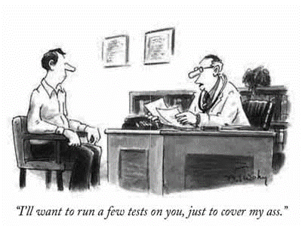

Slide 13
Extra Diagnostic Tests…
The doctor could argue that an ultrasound might miss a more sinister condition like an inflamed appendix or a renal stone but the hidden logic probably has to do with the ease of defending the fact that a more advanced technology test procedure was ordered than defending the failure to order one.
Inexperienced doctors, doctors in high risk environments, and emergency room staff would be more susceptible to this type of practice as a protective shield against liability for malpractice.

Slide 14
Costs of Extra Tests
The substantial costs of high technology tests have attracted more attention from the public and policy makers because of the outcry and publicity from health insurance providers who often cover the costs.
Quality evidence based health care does not translate to succumbing to patient demands to prescribe medicines of questionable value and order costly and probably unnecessary medical tests.

Slide 15
Invasive Medical Tests
Invasive medical tests and procedures are not only costly but could come with significant risks to the patient that ultimately lead to medical complications and subsequent litigation.
A life threatening bleeding episode or a serious allergic reaction from an injected dye can occur during invasive radiological tests involving blood vessel cannulations.
More serious medical complications can arise following procedures such as a caesarian section. This type of surgery has increased as a defensive measure because of litigation concerns when birthing mishaps occur.

Slide 16
Negative Effects of Unwarranted Procedures
Unnecessary procedures that result in major complications typify the effects of defensive medicine on quality of care.
Such procedures may provide an element of protection for the doctor but the overwhelming evidence suggests it increases the cost of care and risks to the patient.
Health insurance companies hike their premiums or co-payments in line with the extra expenses on healthcare services for their members, which further escalates overall healthcare costs.

Slide 17
Limitation of Access to care…Replacing Care
Unnecessary referrals by doctors to other specialists is a common practice in defensive medicine.
This is supported by the finding that 52% of specialists who responded to a research survey referred their patients to other specialists in unnecessary circumstances
Such a high degree of avoidance of treating risky patients by referring them to other specialists further indicates that defensive medicine not only raises the cost of healthcare but also limits access to services
Robeznieks, 2005); Studdert, 2005

Slide 18
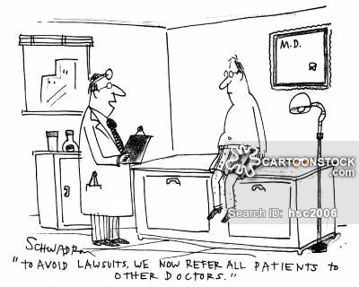

Slide 19
Conflict of Interest in Referrals
Ulterior motives like profit making can also be difficult to differentiate from defensive medicine.
It would be idealistic to fail to acknowledge that doctors as well as hospitals have both economic and humanitarian interests as they treat patients or order diagnostic tests.
Lefton (2008)

Slide 20
Patient Referral Abuse
Laws that control the practice of kickbacks, fraud, and abuse exist and are strictly enforced in countries like the USA (Stark Laws).
The fact that doctors gain commercially from referrals is supported by the competition between hospitals and doctors on their own medical staffs who conduct diagnostic and treatment services.
Radiologists own diagnostic imaging centers and surgeons run ambulatory surgery units. Such facilities inevitably lead to underutilization of hospital imaging and ambulatory surgical services.
The doctor in solo or group practice would be more inclined to refer to his or her own facility rather than to the hospital facility.

Slide 21
Status of Referral Laws
All countries have their versions of laws similar to the Stark laws that currently control doctor referrals of patients in the United States.
Awareness of such laws remains low among both health care administrators and doctors in developing countries.
Although no research data is available on such practices in Kenya, there is empirical evidence that may indicate rampant violation of referral laws in both general medicine and specialist practices.

Slide 22
Way Forward: Staff Support
Hospitals to support the medical staff and allay their fears of litigation in order to provide cost effective and safe health care delivery.
Ready availability of senior emergency department staff would ensure that junior colleagues do not overuse diagnostic facilities due to their lack of experience.

Slide 23
Way forward: Change Behaviors
Encourage behaviors directed at minimizing medical litigation through honestly resolving all disputes by mediation and arbitration.
Full disclosure to a patient when an adverse event occurs and offer of a fair and timely compensation.
Cultivate a culture of safety that fosters open communication and that allows discussion of every missed and near missed error.

Slide 24
Way forward: Avoid External pressure
Doctors should be wary of aggressive marketing from biomedical product manufacturers and the demands of increasingly informed patients on healthcare matters.
Introducing practice guidelines that allow doctors to withhold some low-yield tests or request patients to share some of the costs.

Slide 25
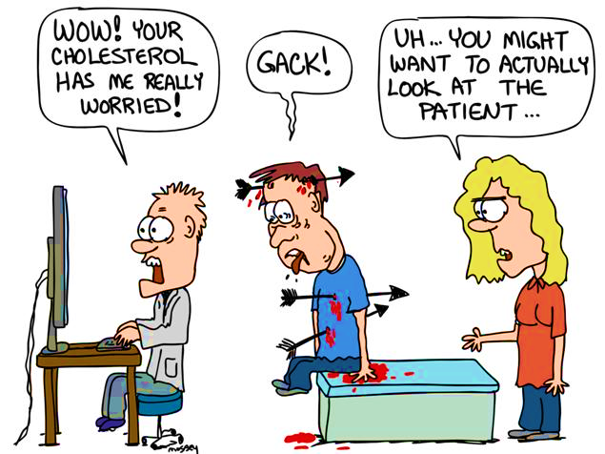

Slide 26
Way Forward: More Care is not Better Care
Tests and treatments should not be carried out unnecessarily as they have associated harms that may lead to malpractice.
Health care providers have a moral, legal, and ethical duty to ascertain that cost effective quality patient care is available to all patients at the lowest possible cost.

Slide 27
Way forward: Improve Patient Centered Care
Quality gains could arise from improved patient-doctor relationships that lead to fewer referrals and avoidance of risky procedures practiced in defensive medicine.
The adoption of patient-centered care and biopsychosocial model of health care with its holistic approach builds trust and discourages defensive medicine.
Conduct local research on defensive medicine and its effects on health care costs.
Adwok & Wolskee, 2012

Slide 28
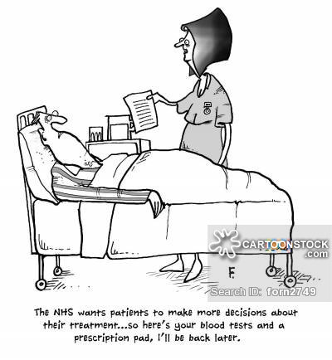

Slide 29
Thank you.

